Slide 1

Vrinda Store Data Analysis
Group 3

Slide 2
Sample Questions
Compare the sales and orders using single chart.
Which month got the highest sales and orders?
Who purchased more- men or women in 2022?
What are different order status in 2022?
List top 5 states contributing to the sales?
Relation between age and gender based on number or orders.
Which channel is contributing to maximum sales?
Highest selling category?, etc.

Slide 3
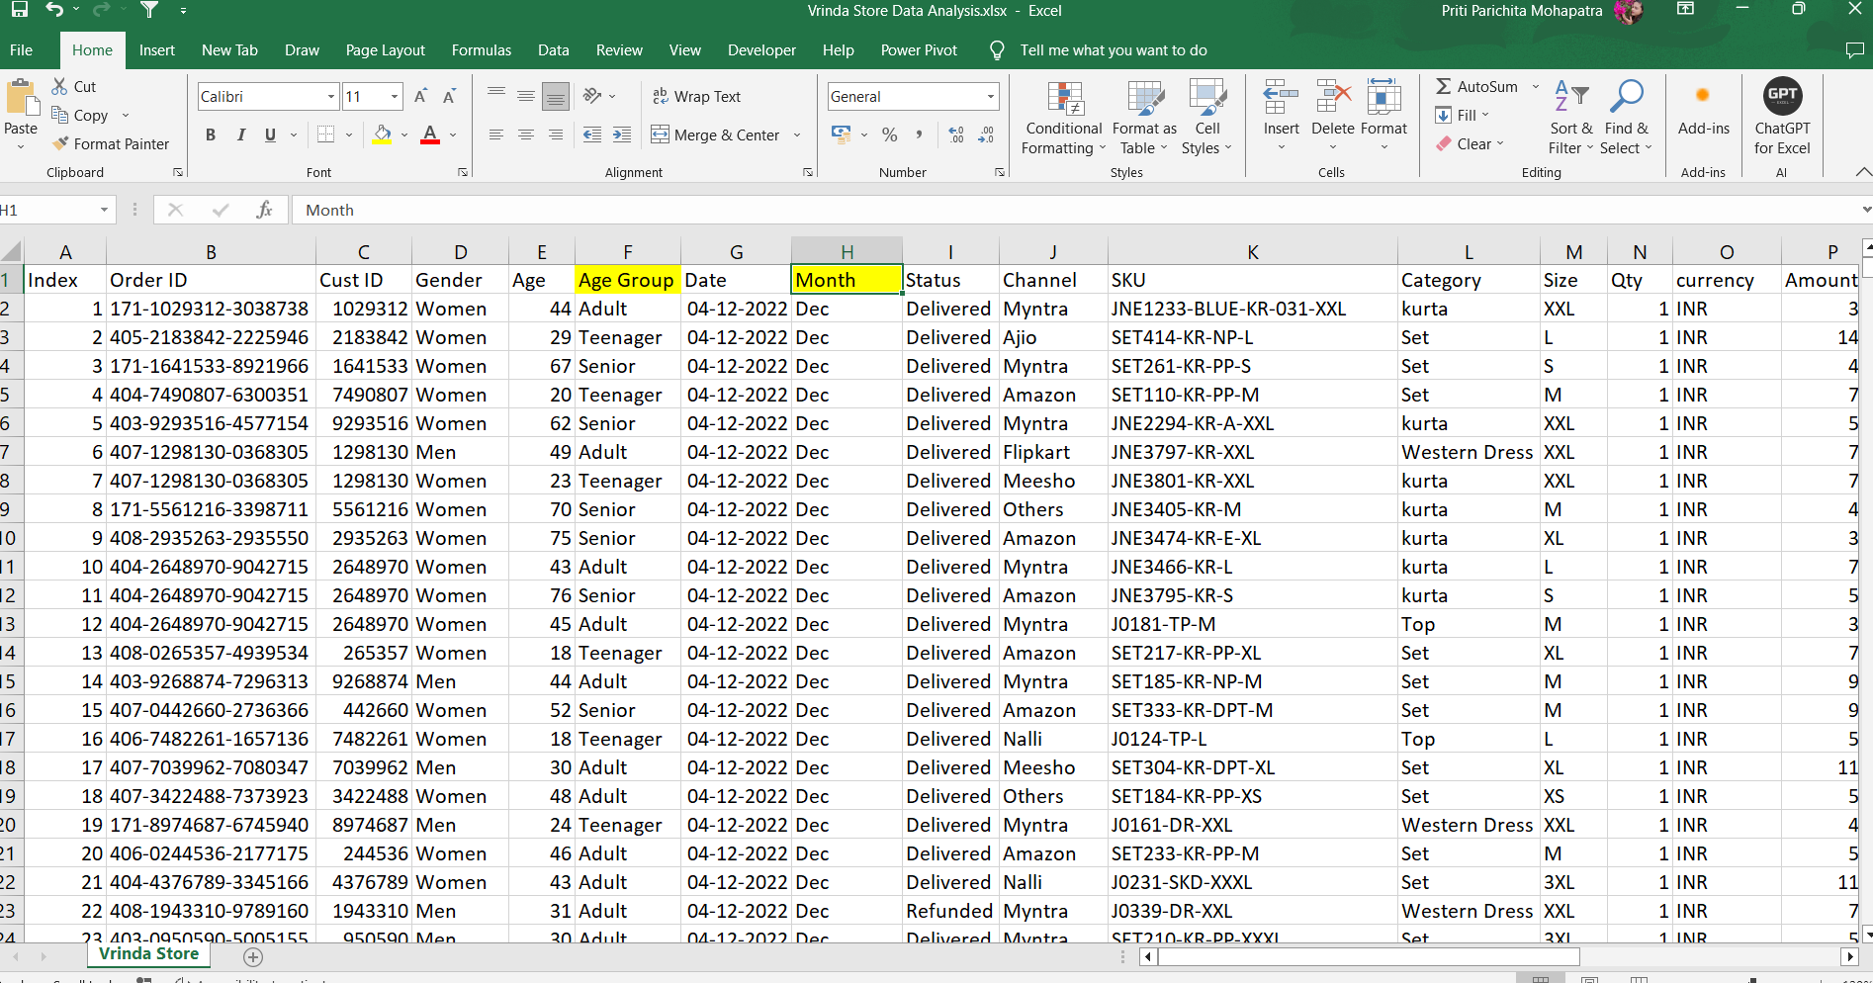
The yellow mark in the dataset defines the function we added here.
For the relation between age and gender we create age group here by the use of If function.
E.g: IF(E2>=50,"Senior",IF(E2>=30,"Adult","Teenager"))
For highest sales and orders of the month we create month column by the use of text function.
E.g: TEXT(G2,”mmm”)

Slide 4
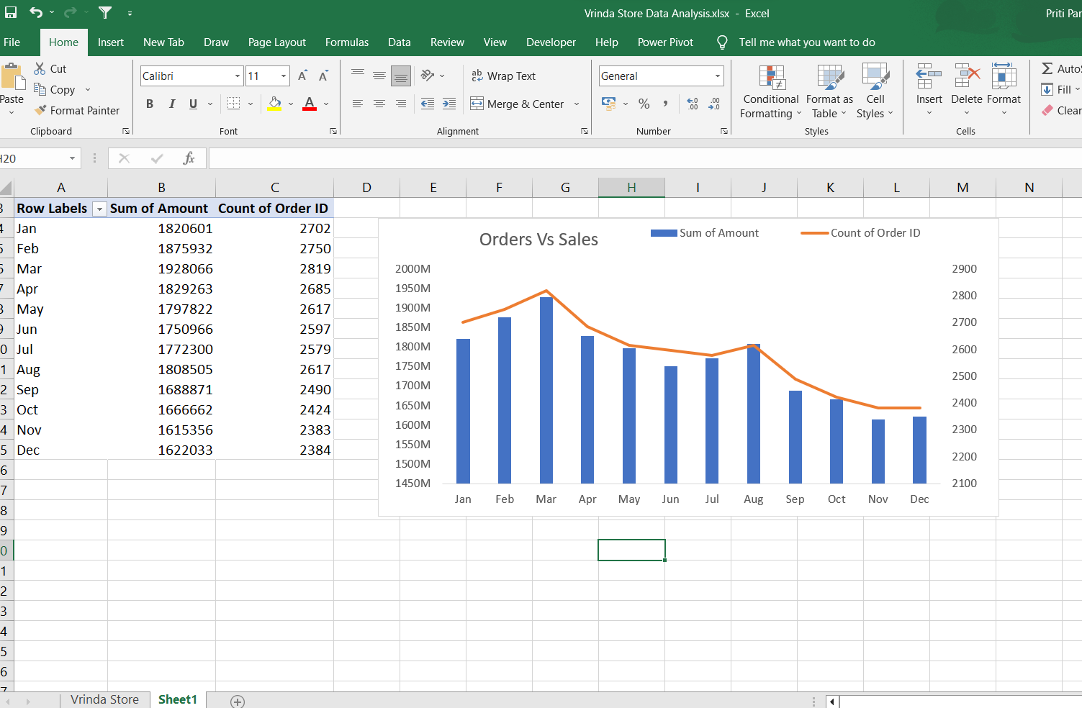
In his pivot table we compare the sales and orders using single chart

Slide 5
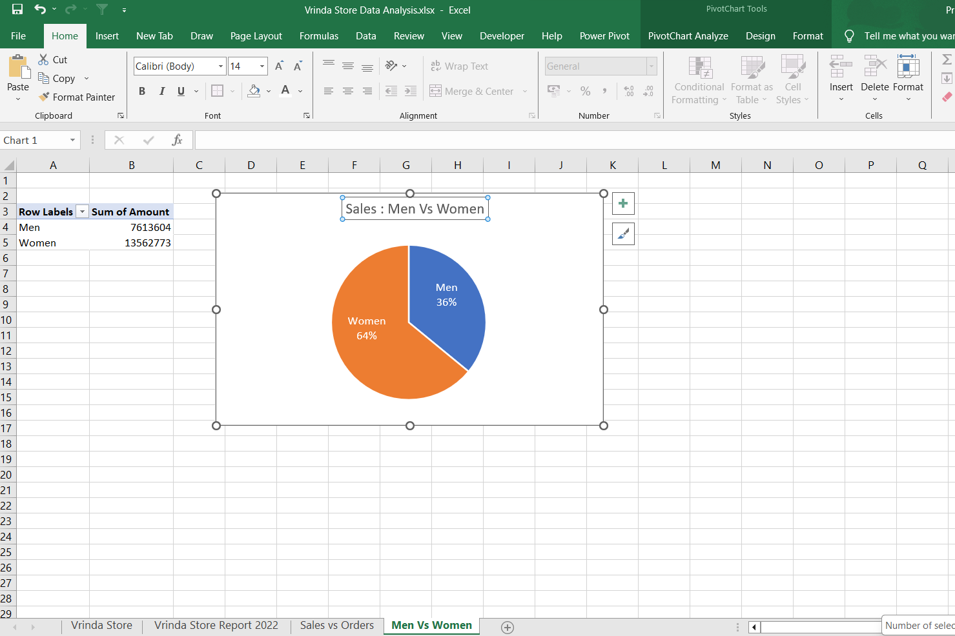
Here we compare the purchase rate of Men and Women

Slide 6
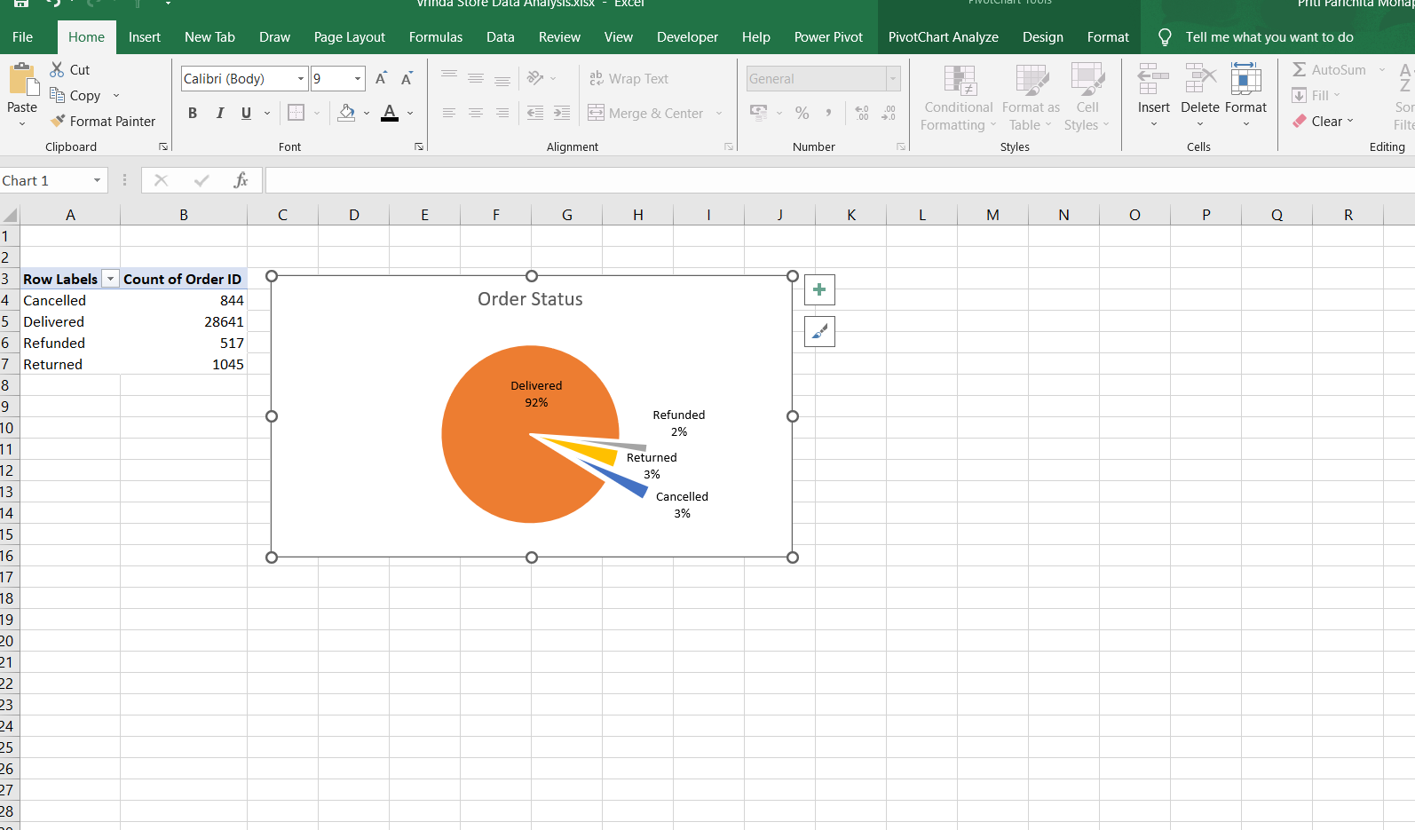
Here, we can analyse the order status

Slide 7
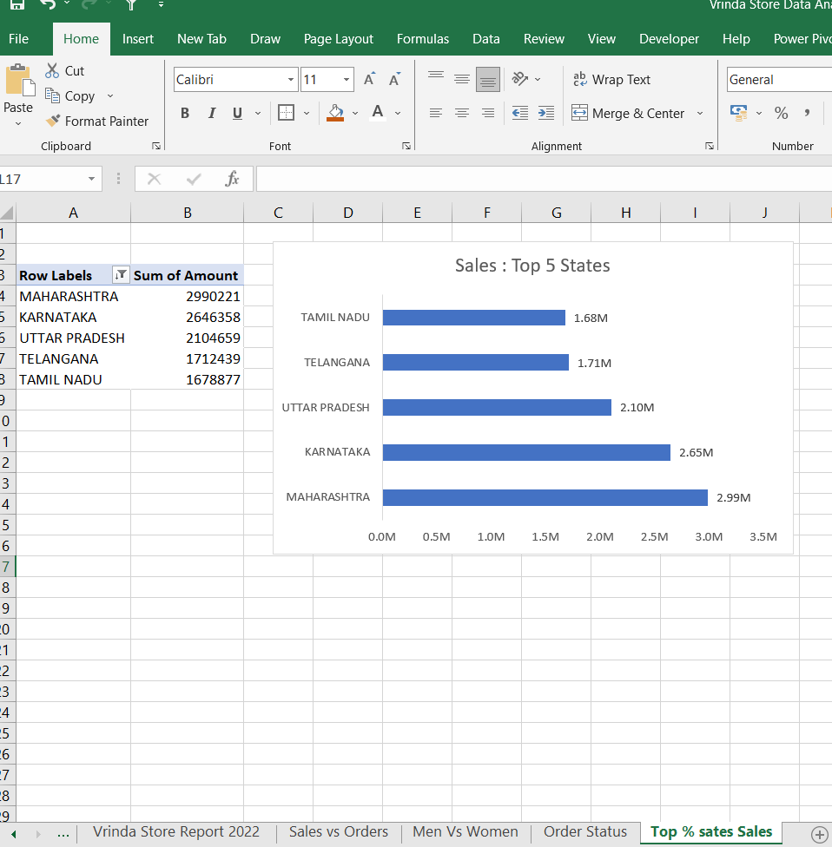
Here we did Top 5 States Sales value by using SORT and FILTER

Slide 8
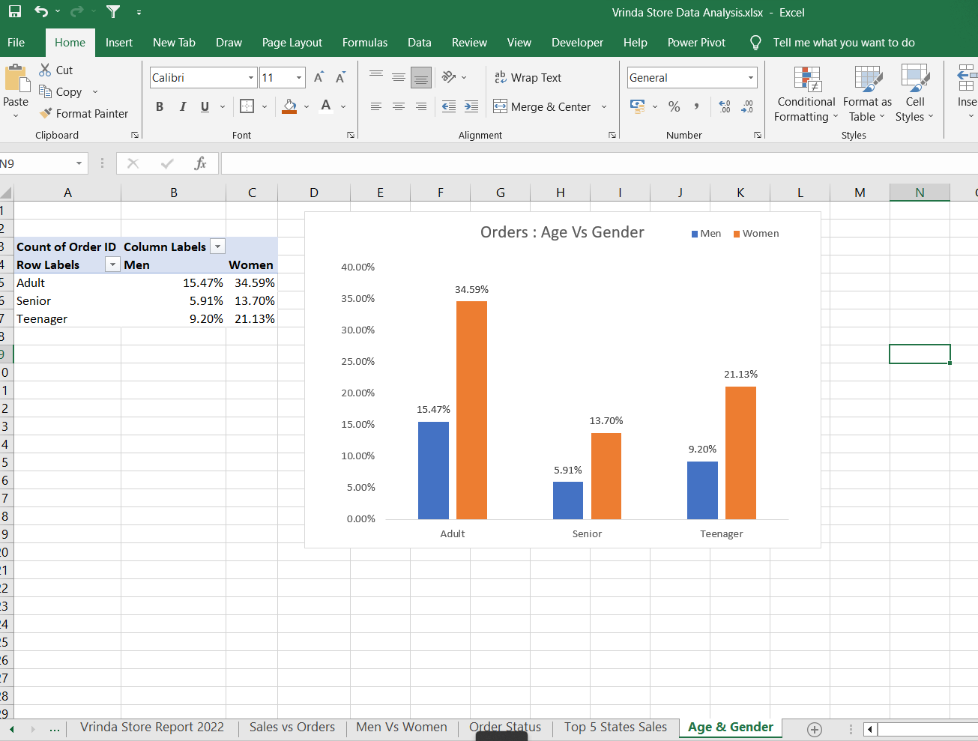
Here, we show the data relation between age and number of orders

Slide 9
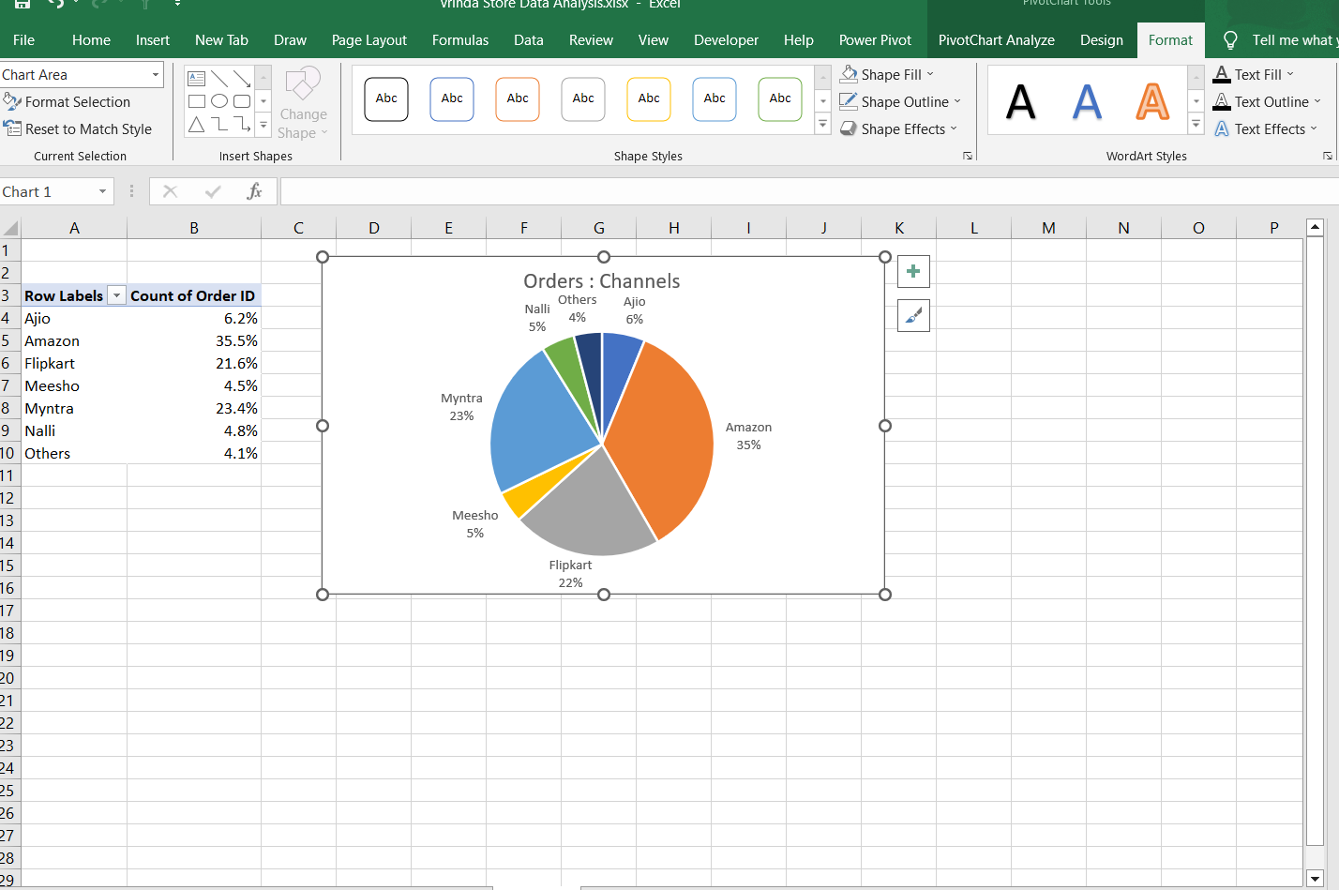
Here, we showing the channel contributing to maximum orders

Slide 10
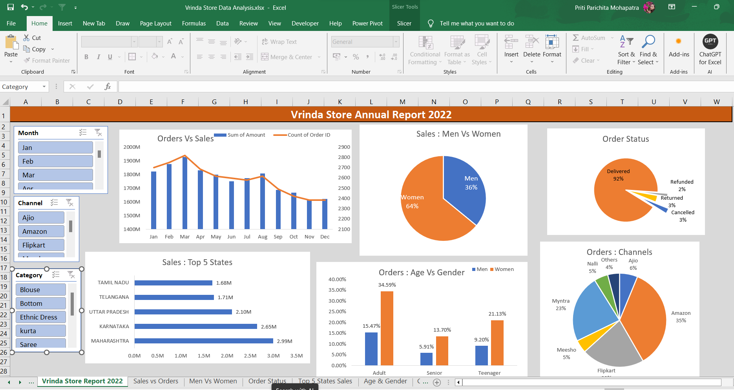
Here, we made the main dashboard by using the pivot chart and slicer.
We made it dynamic dashboard , according to the slicer change the dashboard will change.

Slide 11
Thank you !!!
Group 3:
Kishor Wakchaure
Priti Parichita Mohapatra
Pooja Bamne
Vijay Waghe
Manal Khan
Komal Jain
Richa Porwal

